Slide 1
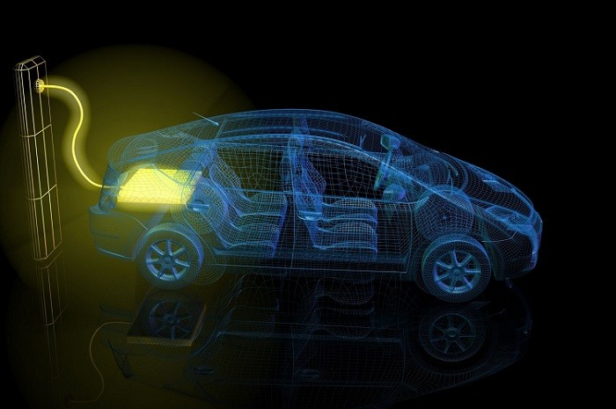

ELECTRIC VEHICLES
DATA ANALYSIS AND VISUAL REPRESENTATION
(DONE USING TABLEAU PUBLIC)

Slide 2
Problem statement:
Total vehicles by Model Year (2010 onwards) visualized by a line and area chart.
Total vehicles in each state visualized in a map chart.
Top 10 total vehicles listed by manufacturers shown in a bar diagram.
Total number of vehicles by Clean Alternative Fuel Vehicle (CAFV) eligibility shown with the help of a donut chart.
Top 10 total vehicles by Model visualized with a Tree Map

Slide 3
KPIs: The following Key Performance Indicators are quantifiable metrics that will track the quality, performance and impact of the data.
The total number of vehicles categorized as Battery Electric Vehicles (BEV) and Plug-in Hybrid
Electric Vehicles (PHEV).
[This will help in assessing the market size and growth.]
2. The average electric range from the information given.
[It will gauge the efficiency of the EVs and understand the level of technological advancement in this
sector.
3. The total number of PHEVs and their percentage in total vehicles.
4. The total number of BEVs and their percentage in total vehicles.

Slide 4
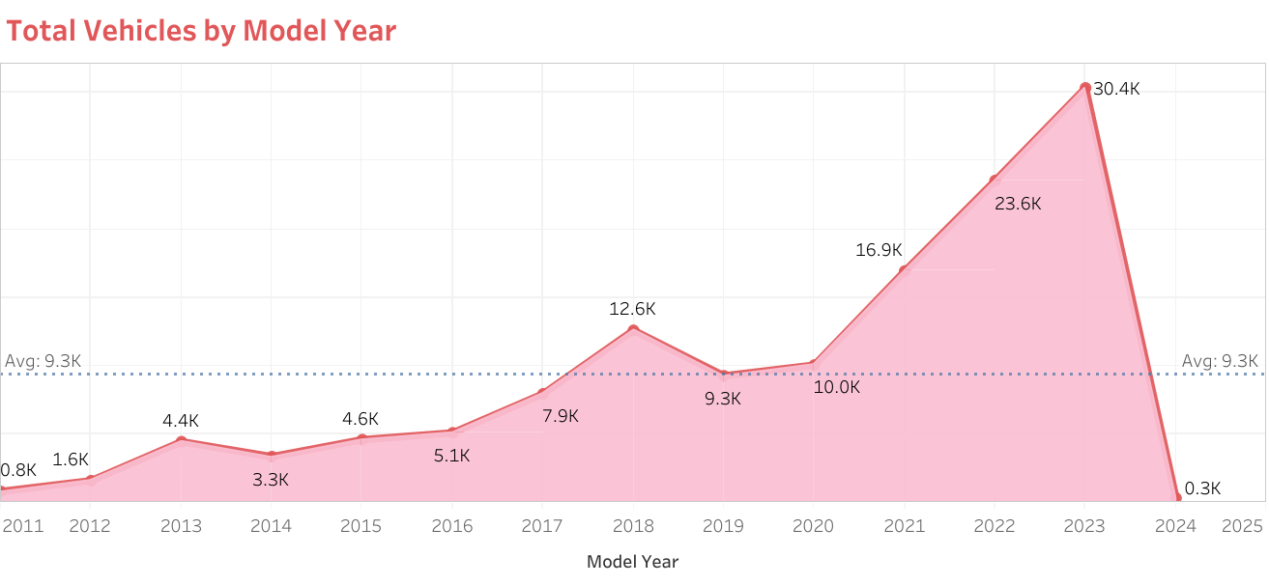

Slide 5
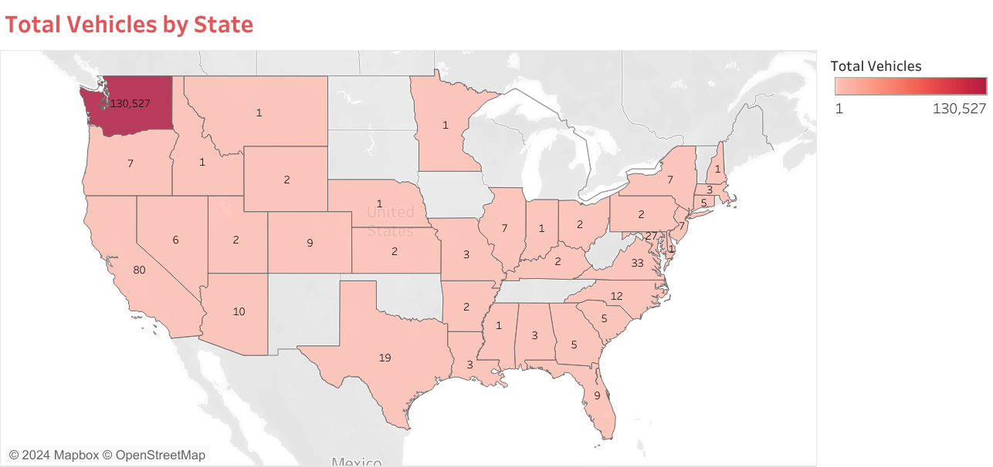

Slide 6
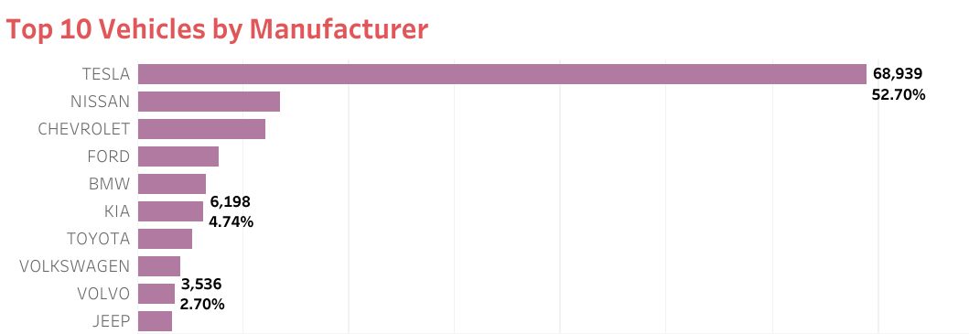

Slide 7
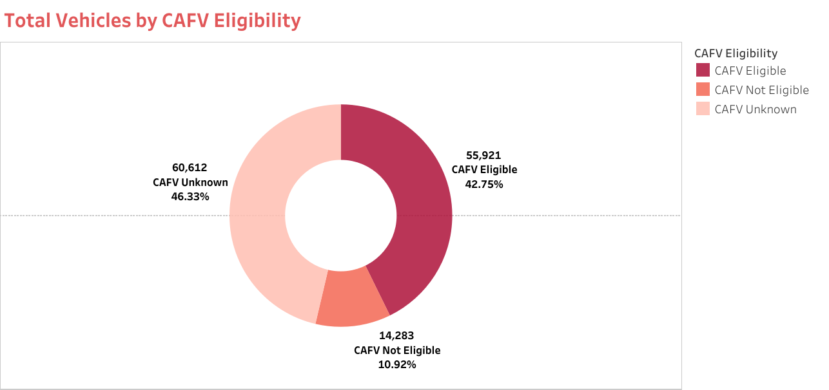

Slide 8
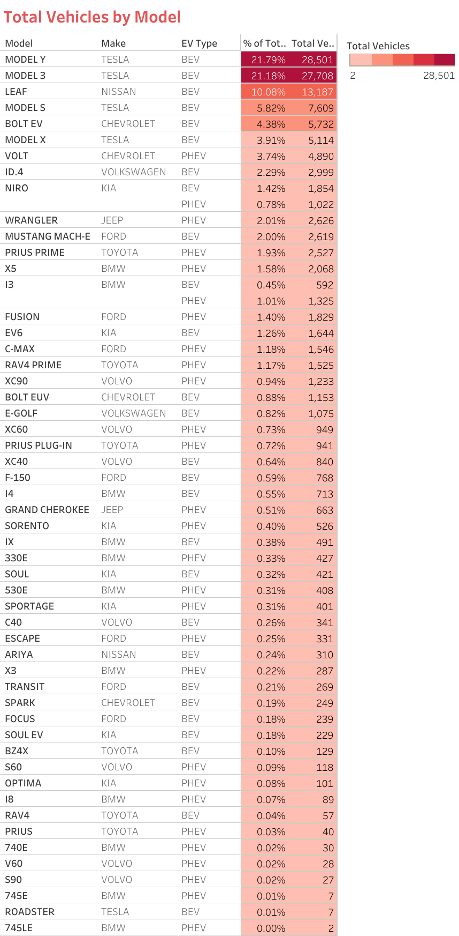

Slide 9
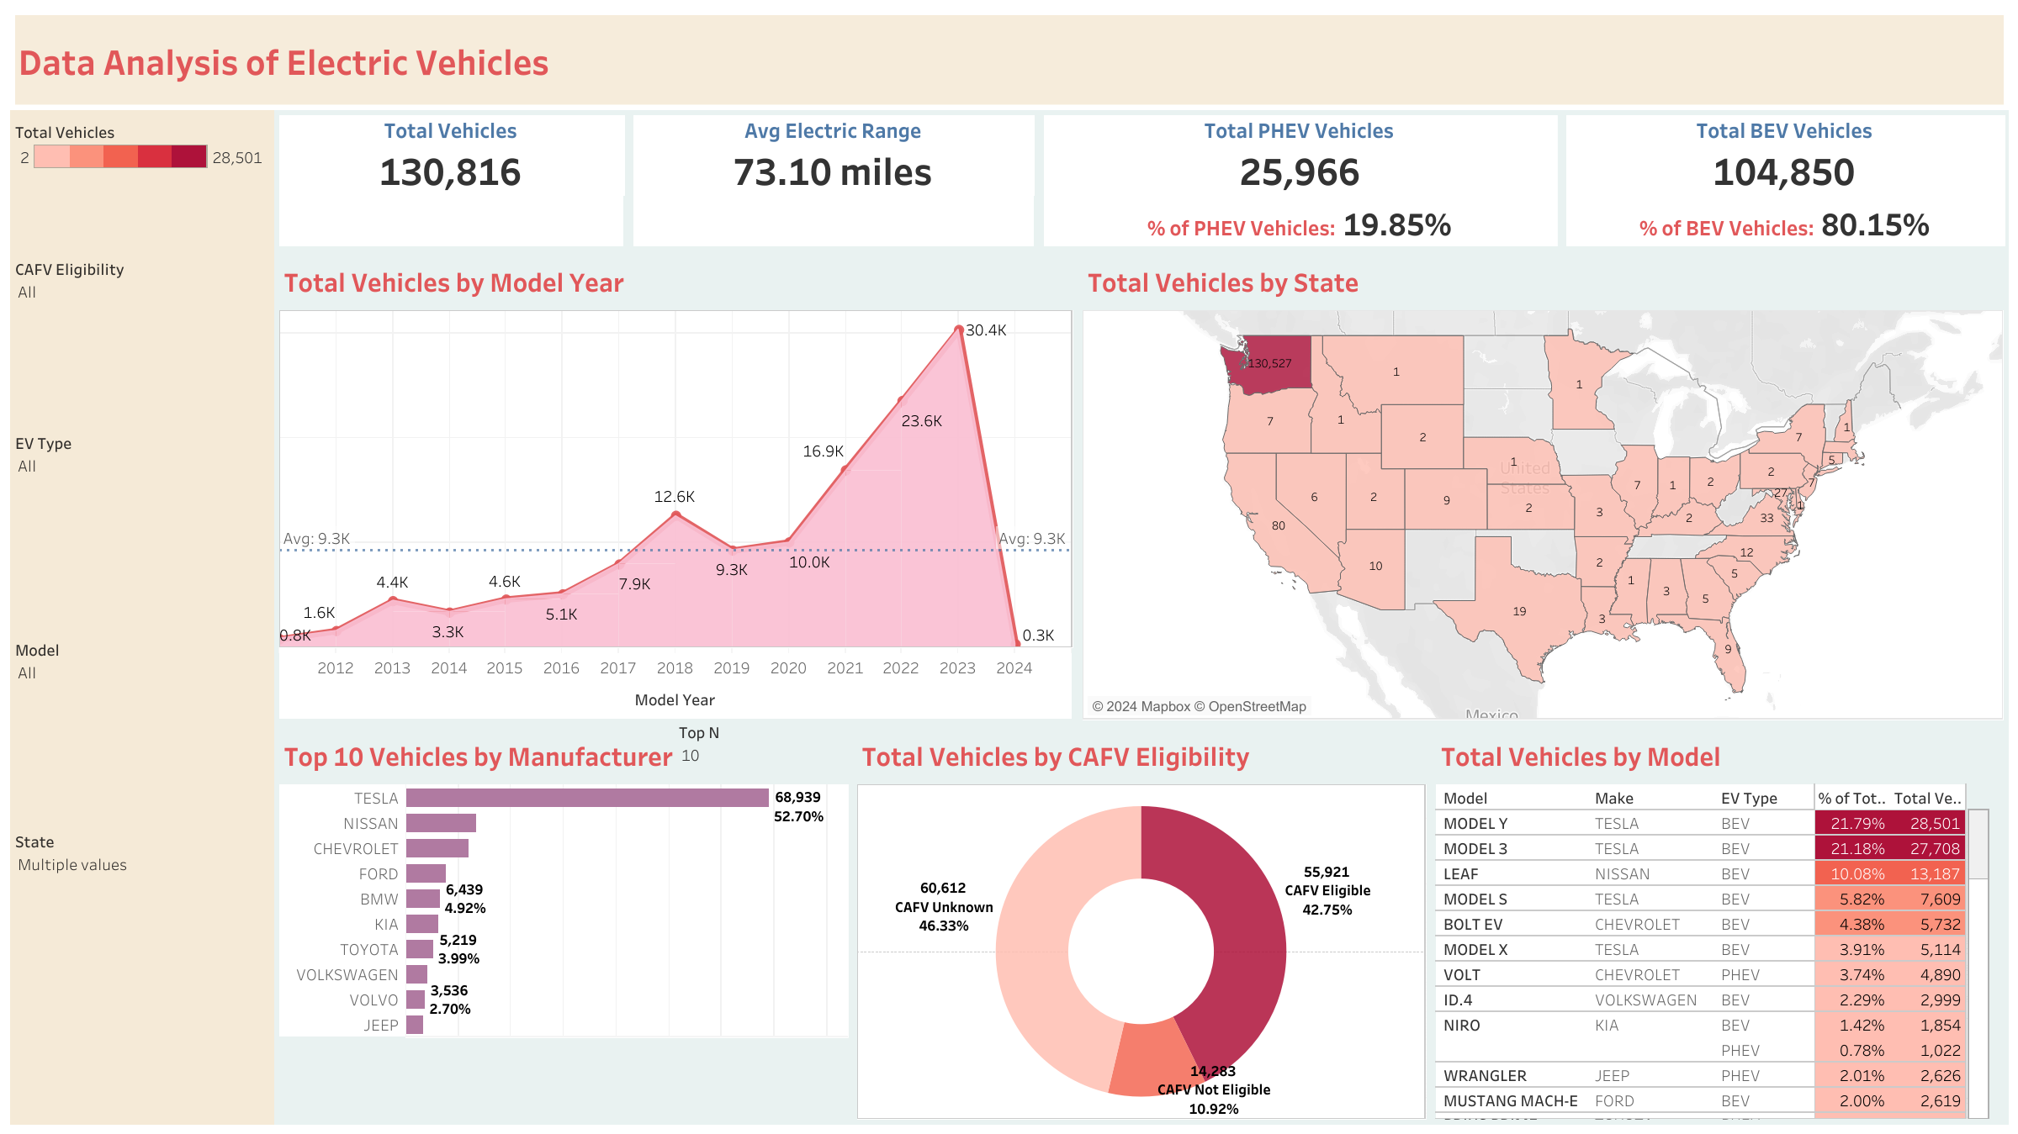

Slide 10
INSIGHTS:
There has been exponential growth in electronic vehicles in all years since 2010 with the biggest leap being in 2023.
The data is mainly for the Washington area so the other states are not properly represented.
Tesla has captured almost 70% of the market share of EVs followed by Nissan and Chevrolet.
Out of the top 5 models, three of them (1st, 2nd and 4th) belong to Tesla.
There is a significant amount of vehicles with unknown CAFV.

Slide 11

CONCLUSION:
There is room for improvement with the dire need of CAFV eligibility. Other companies besides Tesla need to gear up to make the Electric Vehicle market more competitive. Better and more accurate collection of data especially from the other states would also aid the research process more.

Slide 12

THANK YOU!

